Slide 1
Probabilistic Robotics
FastSLAM

Slide 2
The SLAM Problem
SLAM stands for simultaneous localization and mapping
The task of building a map while estimating
the pose of the robot relative to this map
Why is SLAM hard?
Chicken and egg problem:
a map is needed to localize the robot and
a pose estimate is needed to build a map

Slide 3
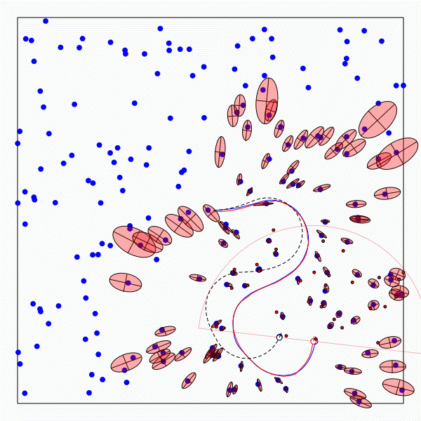
The SLAM Problem
A robot moving though an unknown, static environment
Given:
  The robot’s controls
  Observations of nearby features
Estimate:
  Map of features
  Path of the robot

Slide 4
Why is SLAM a hard problem?
SLAM: robot path and map are both unknown!
Robot path error correlates errors in the map

Slide 5
Why is SLAM a hard problem?
Robot pose
uncertainty
In the real world, the mapping between observations and landmarks is unknown
Picking wrong data associations can have catastrophic consequences
Pose error correlates data associations

Slide 6
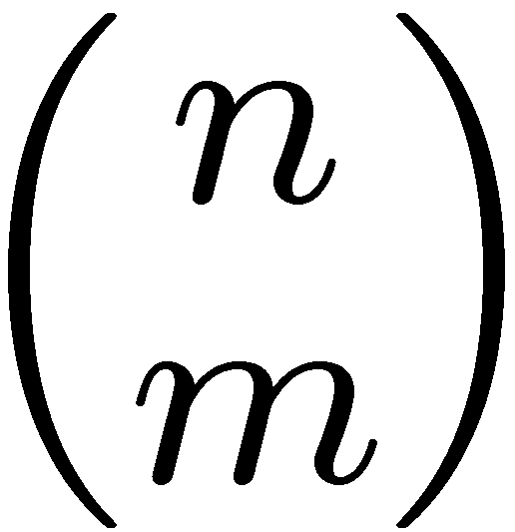
Data Association Problem
A data association is an assignment of observations to landmarks
In general there are more than
(n observations, m landmarks) possible associations
Also called “assignment problem”

Slide 7
Particle Filters
Represent belief by random samples
Estimation of non-Gaussian, nonlinear processes
Sampling Importance Resampling (SIR) principle
  Draw the new generation of particles
  Assign an importance weight to each particle
  Resampling
Typical application scenarios are
tracking, localization, …

Slide 8
Localization vs. SLAM
A particle filter can be used to solve both problems
Localization: state space < x, y, θ>
SLAM: state space < x, y, θ, map>
  for landmark maps = < l₁, l₂, …, l_{m}>
  for grid maps = < c₁₁, c₁₂, …, c_{1n}, c₂₁, …, c_{nm}>
Problem: The number of particles needed to represent a posterior grows exponentially with
the dimension of the state space!

Slide 9
Dependencies
Is there a dependency between the dimensions of the state space?
If so, can we use the dependency to solve the problem more efficiently?

Slide 10
Dependencies
Is there a dependency between the dimensions of the state space?
If so, can we use the dependency to solve the problem more efficiently?
In the SLAM context
  The map depends on the poses of the robot.
  We know how to build a map given the position of the sensor is known.

Slide 11
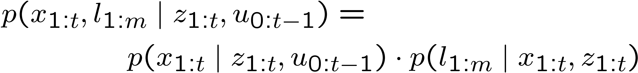
Factored Posterior (Landmarks)
poses
map
observations & movements
SLAM posterior
Robot path posterior
landmark positions
Does this help to solve the problem?
Factorization first introduced by Murphy in 1999

Slide 12
Factored Posterior (Landmarks)
poses
map
observations & movements
Factorization first introduced by Murphy in 1999

Slide 13
Mapping using Landmarks
Landmark 1
l₁
z₁
z₃
observations
x₀
x₁
x₂
x₃
. . .
x_{t}
Robot poses
u₁
controls
u₀
u₁
u_{t-1}
z₂
z_{t}
l₂
Landmark 2
Knowledge of the robot’s true path renders landmark positions conditionally independent

Slide 14
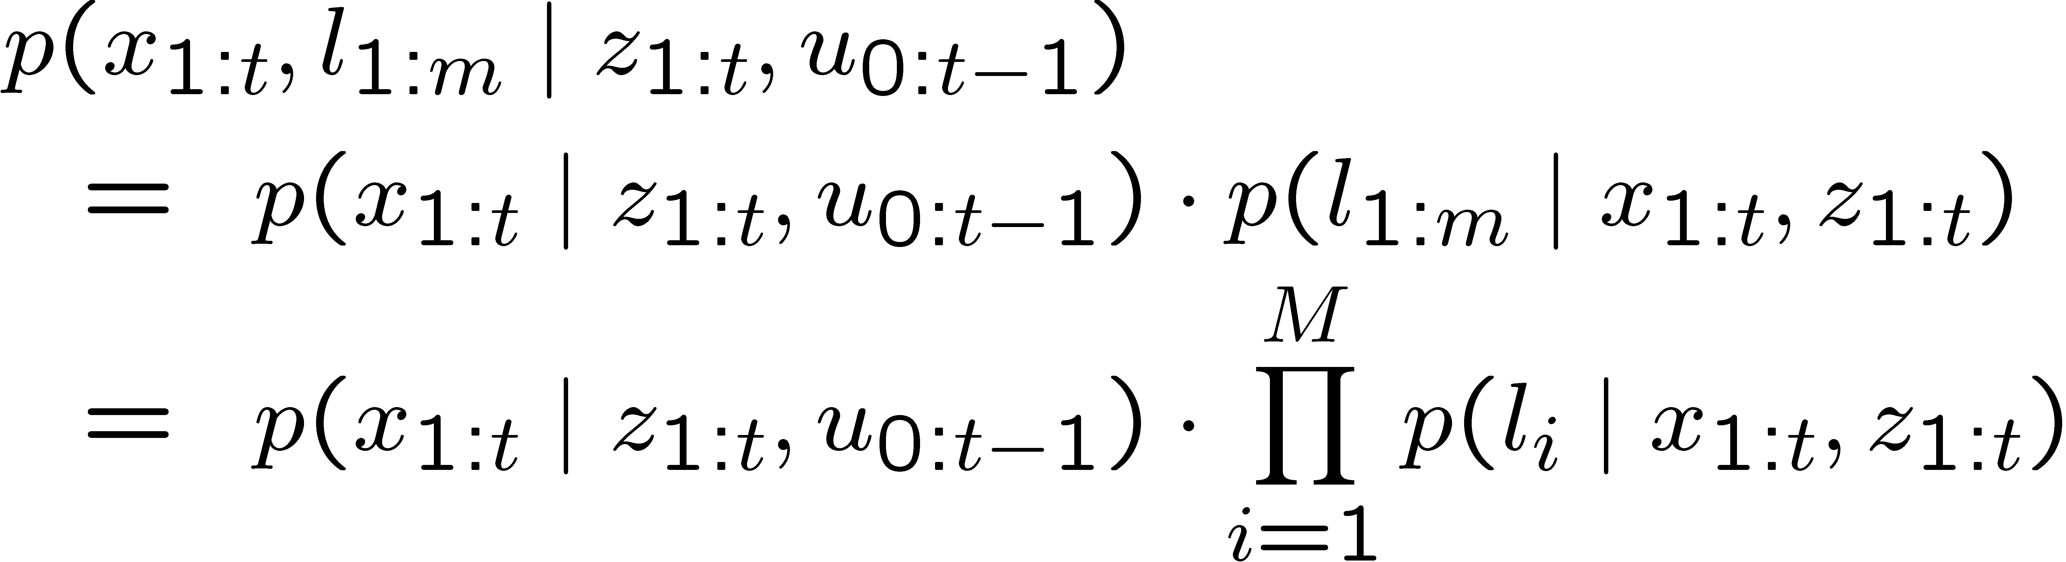
Factored Posterior
Robot path posterior
(localization problem)
Conditionally independent
landmark positions

Slide 15
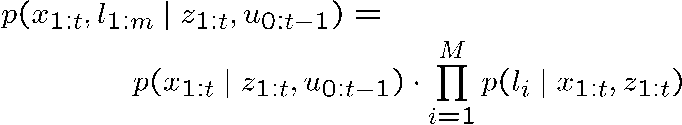
Rao-Blackwellization
This factorization is also called Rao-Blackwellization
Given that the second term can be computed efficiently, particle filtering becomes possible!

Slide 16
FastSLAM
Rao-Blackwellized particle filtering based on landmarks [Montemerlo et al., 2002]
Each landmark is represented by a 2x2
Extended Kalman Filter (EKF)
Each particle therefore has to maintain M EKFs
Particle
#1
x, y, θ
Landmark 1
Landmark 2
Landmark M
…
Particle
#2
x, y, θ
Landmark 1
Landmark 2
Landmark M
…
…
Particle
N
x, y, θ
Landmark 1
Landmark 2
Landmark M
…

Slide 17
FastSLAM – Action Update
Landmark #1
Filter
Particle #1
Landmark #2
Filter
Particle #2
Particle #3

Slide 18
FastSLAM – Sensor Update
Landmark #1
Filter
Particle #1
Landmark #2
Filter
Particle #2
Particle #3

Slide 19
FastSLAM – Sensor Update
Particle #1
Weight = 0.8
Particle #2
Weight = 0.4
Particle #3
Weight = 0.1

Slide 20
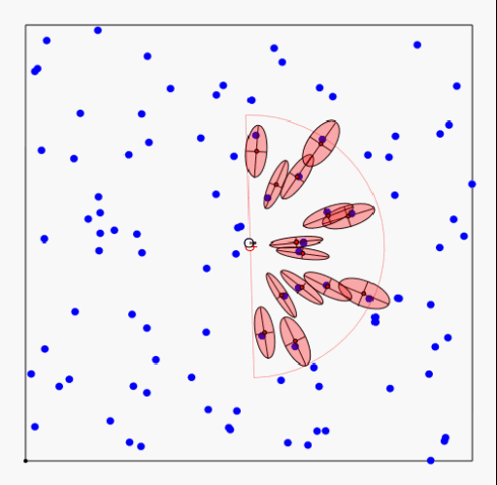
FastSLAM - Video

Slide 21
FastSLAM Complexity
O(N)
Update robot particles based on control u_{t-1}
Incorporate observation z_{t} into Kalman filters
Resample particle set
Constant time per particle
O(N•log(M))
Log time per particle
O(N•log(M))
Log time per particle
N = Number of particles
M = Number of map features
O(N•log(M))
Log time per particle

Slide 22
Data Association Problem
Which observation belongs to which landmark?
A robust SLAM must consider possible data associations
Potential data associations depend also
on the pose of the robot

Slide 23
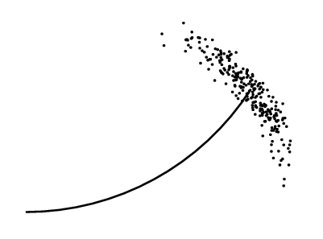
Multi-Hypothesis Data Association
Data association is done on a per-particle basis
Robot pose error is factored out of data association decisions

Slide 24
Per-Particle Data Association
Was the observation
generated by the red
or the blue landmark?
P(observation|red) = 0.3
P(observation|blue) = 0.7
Two options for per-particle data association
  Pick the most probable match
  Pick an random association weighted by
  the observation likelihoods
If the probability is too low, generate a new landmark

Slide 25
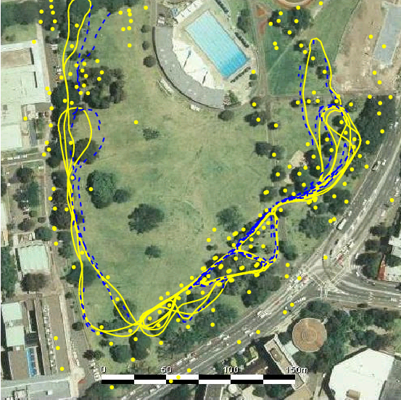
Results – Victoria Park
4 km traverse
< 5 m RMS position error
100 particles
Blue = GPS
Yellow = FastSLAM
Dataset courtesy of University of Sydney

Slide 26
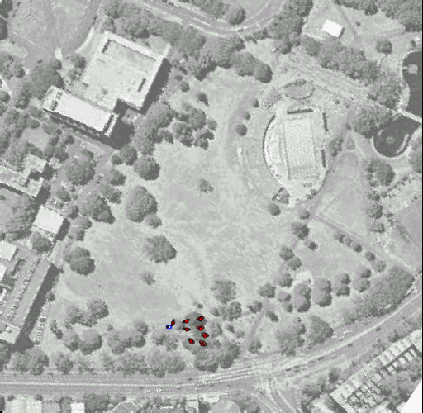
Results – Victoria Park
Dataset courtesy of University of Sydney

Slide 27
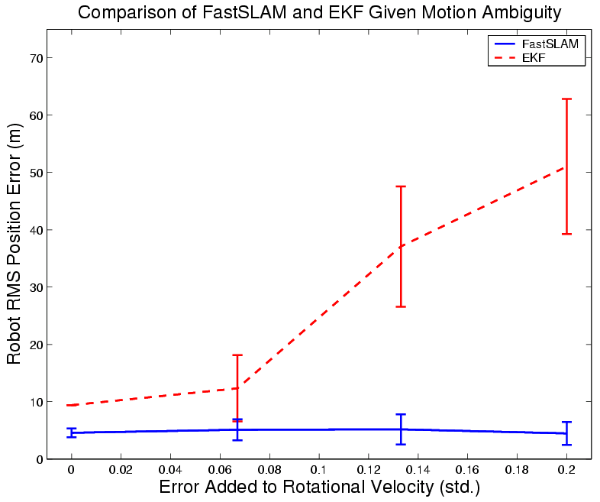
Results – Data Association

Slide 28
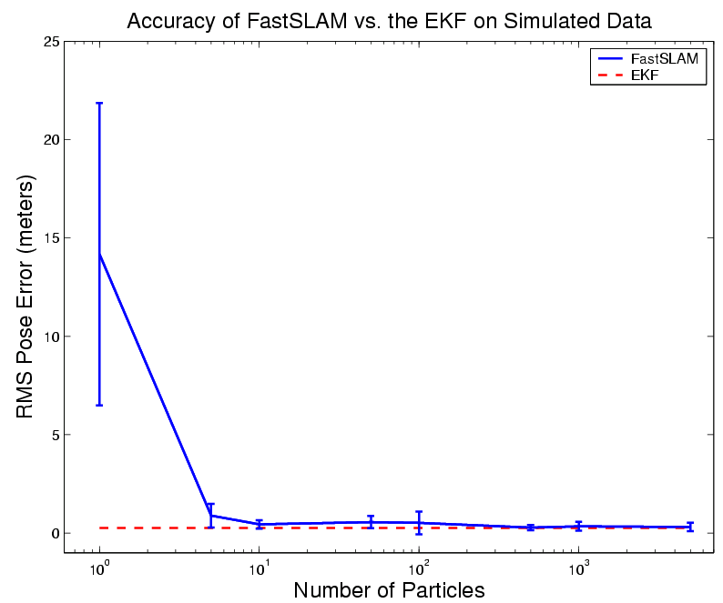
Results – Accuracy

Slide 29
Grid-based SLAM
Can we solve the SLAM problem if no pre-defined landmarks are available?
Can we use the ideas of FastSLAM to build grid maps?
As with landmarks, the map depends on the poses of the robot during data acquisition
If the poses are known, grid-based mapping is easy (“mapping with known poses”)

Slide 30

Mapping using Raw Odometry

Slide 31

Mapping with Known Poses
Mapping with known poses using laser range data

Slide 32
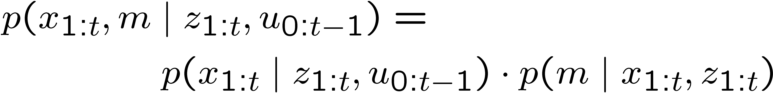
Rao-Blackwellization
poses
map
observations & movements
Factorization first introduced by Murphy in 1999

Slide 33
Rao-Blackwellization
poses
map
observations & movements
SLAM posterior
Robot path posterior
Mapping with known poses
Factorization first introduced by Murphy in 1999

Slide 34
Rao-Blackwellization
This is localization, use MCL
Use the pose estimate
from the MCL part and apply
mapping with known poses

Slide 35
A Graphical Model of Rao-Blackwellized Mapping
u
u
u
0
1
t-1
x
x
x
...
x
0
1
2
t
m
z
z
z
1
2
t

Slide 36
Rao-Blackwellized Mapping
Each particle represents a possible trajectory of the robot
Each particle
  maintains its own map and
  updates it upon “mapping with known poses”
Each particle survives with a probability proportional to the likelihood of the observations relative to its own map

Slide 37
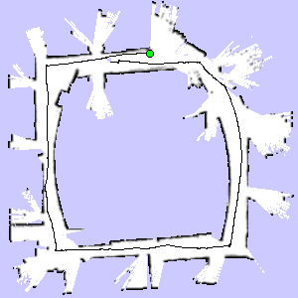
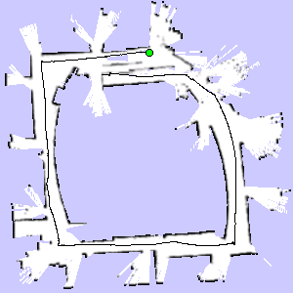

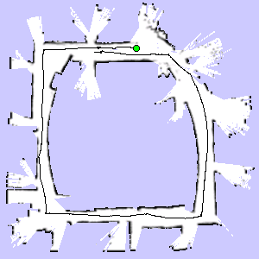
Particle Filter Example
3 particles
map of particle 1
map of particle 3
map of particle 2

Slide 38
Problem
Each map is quite big in case of grid maps
Since each particle maintains its own map
Therefore, one needs to keep the number of particles small
Solution:
Compute better proposal distributions!
Idea:
Improve the pose estimate before applying the particle filter

Slide 39
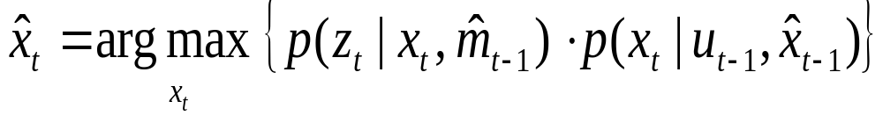
Pose Correction Using Scan Matching
Maximize the likelihood of the i-th pose and map relative to the (i-1)-th pose and map
current measurement
robot motion
map constructed so far
Notes:
To compute consistent maps, we apply a recursive scheme.
At each point in time we compute the most likely position of the robot, given the map constructed so far.
Based on the position hat l-t, we then extend the map an incorporate the scan obtained at time t.

Slide 40
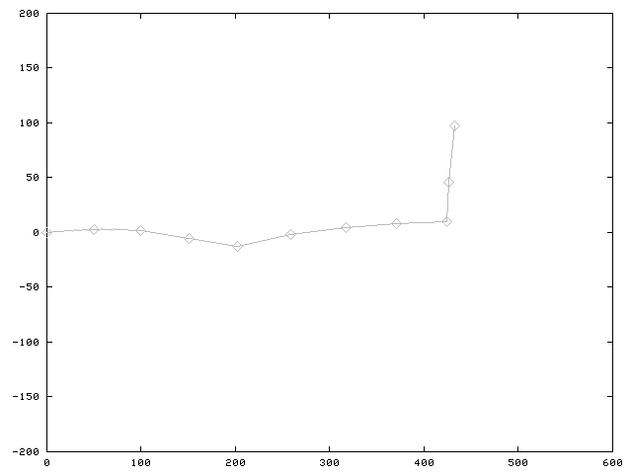
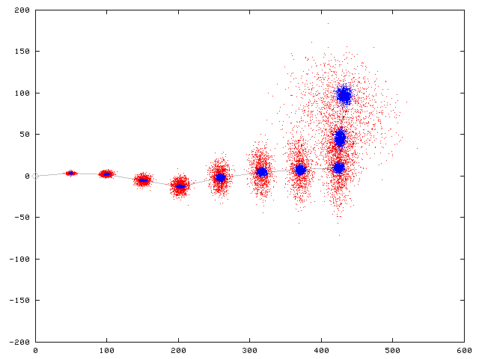
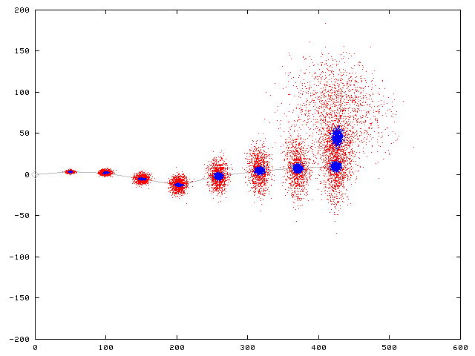
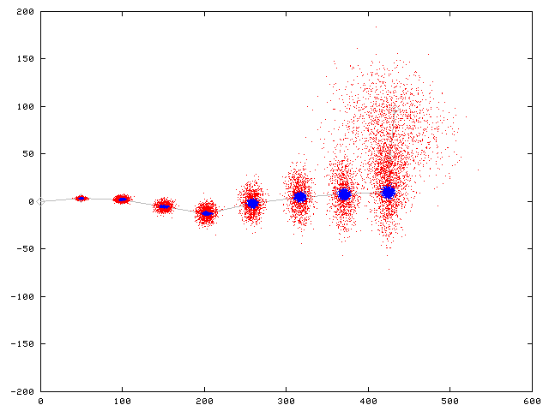
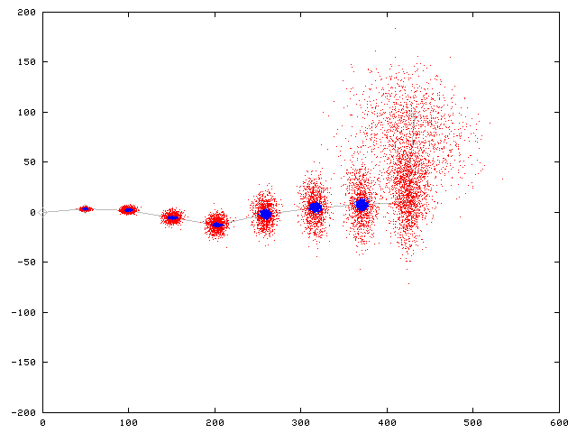







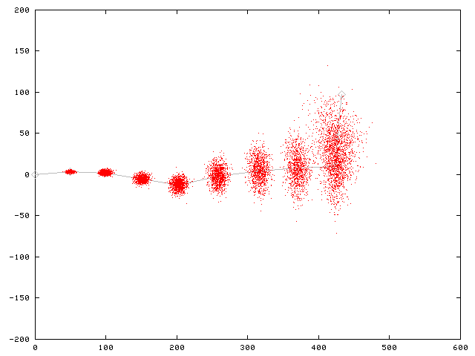
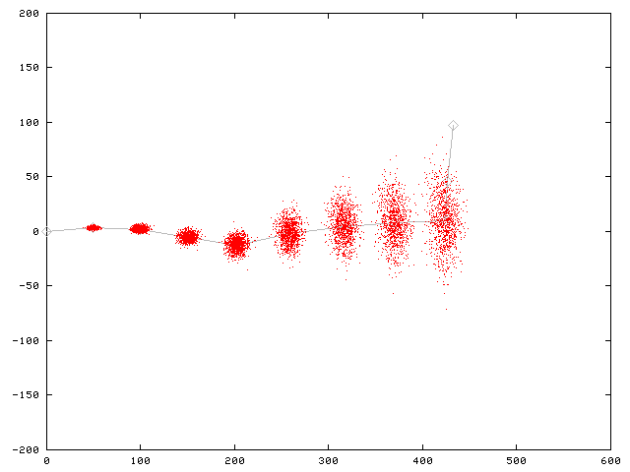
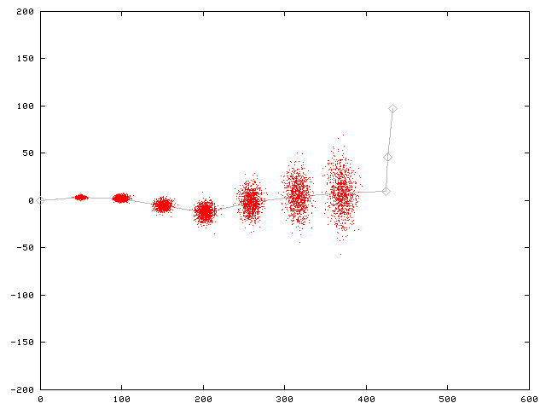
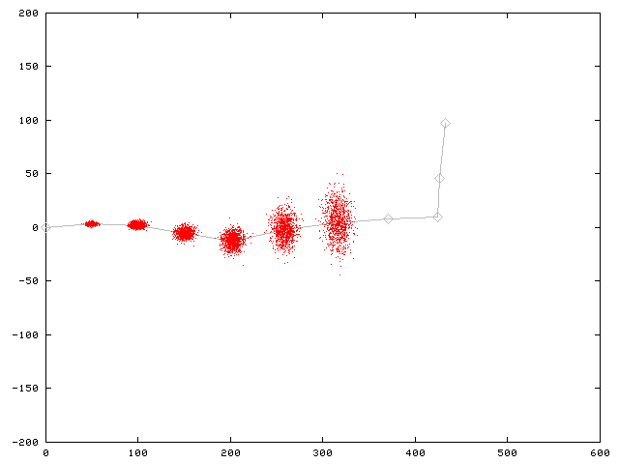
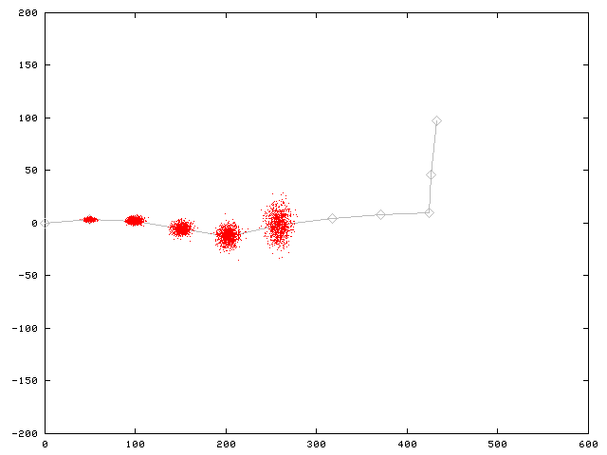
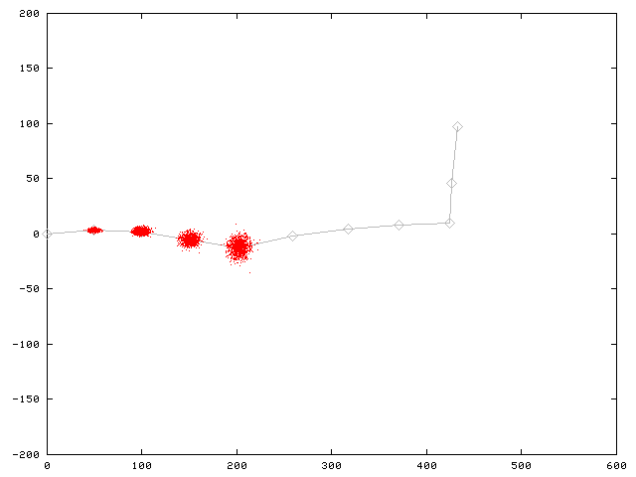
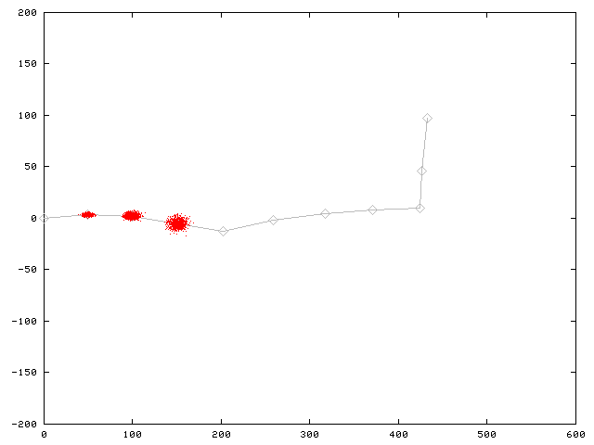
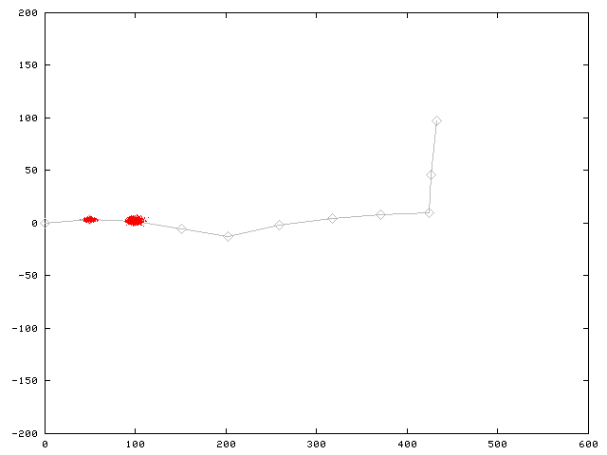
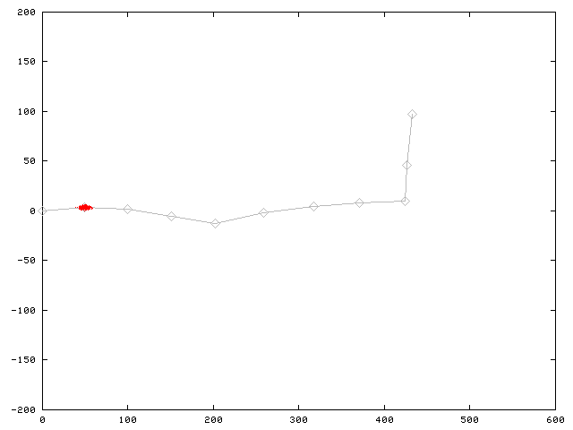
Motion Model for Scan Matching
Raw Odometry
Scan Matching

Slide 41

Mapping using Scan Matching

Slide 42
FastSLAM with Improved Odometry
Scan-matching provides a locally consistent pose correction
Pre-correct short odometry sequences using scan-matching and use them as input to FastSLAM
Fewer particles are needed, since the error in the input in smaller
[Haehnel et al., 2003]

Slide 43
Graphical Model for Mapping with Improved Odometry
u
...
u
u
...
u
u
...
u
0
z
k-1
k
z
2k-1
...
n·k
(n+1)·k-1
z
...
z
...
z
...
z
1
k-1
k+1
2k-1
n·k+1
(n+1)·k-1
u'
u'
...
u'
1
2
n
x
x
x
...
x
0
k
2k
n·k
m
z
z
...
z
k
2k
n·k

Slide 44
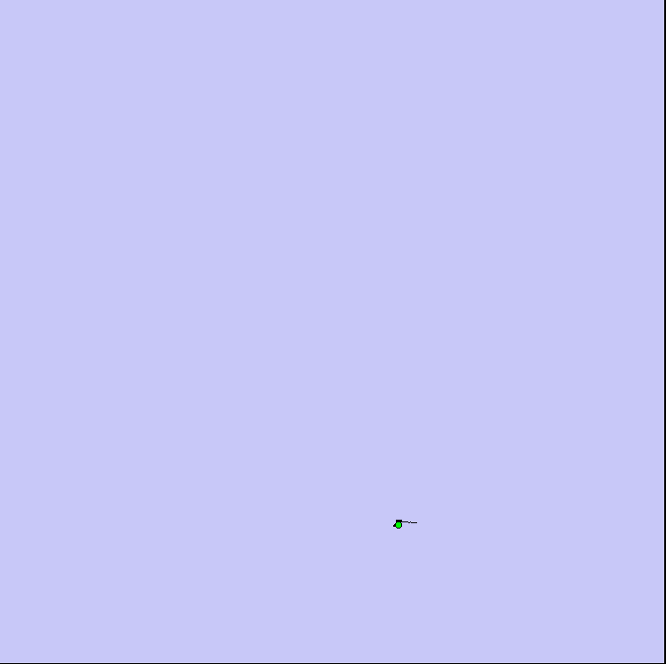
FastSLAM with Scan-Matching

Slide 45
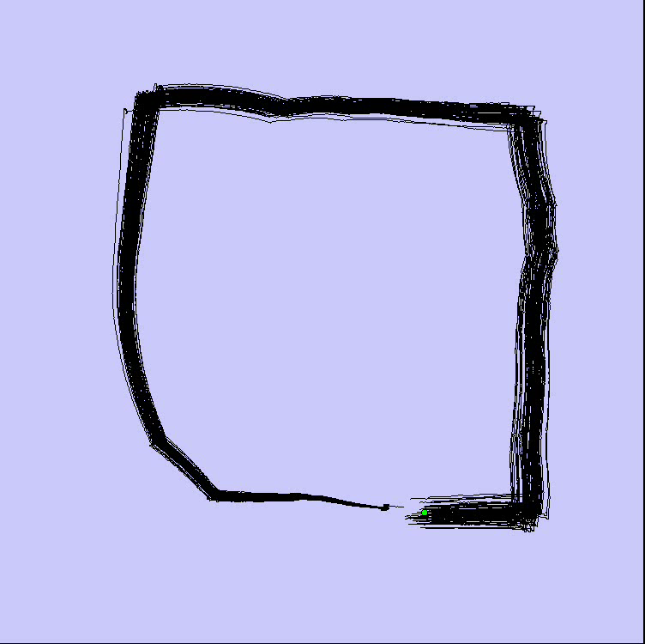
FastSLAM with Scan-Matching
Loop Closure

Slide 46
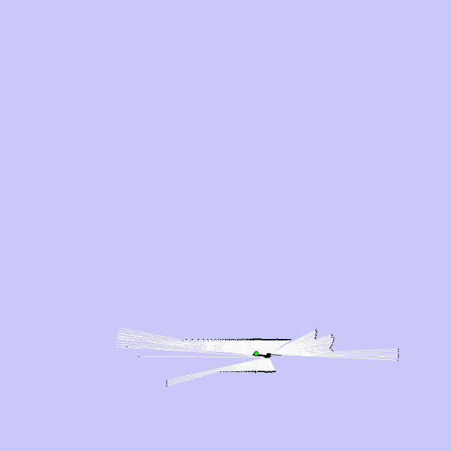
FastSLAM with Scan-Matching
Map: Intel Research Lab Seattle

Slide 47
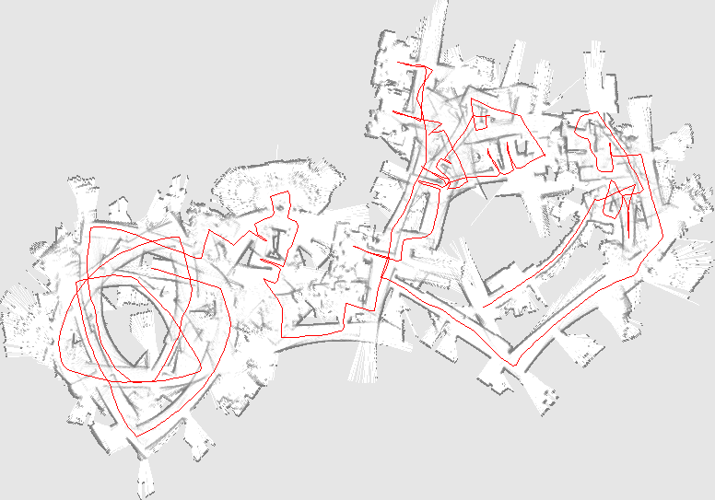
Comparison to Standard FastSLAM
Same model for observations
Odometry instead of scan matching as input
Number of particles varying from 500 to 2.000
Typical result:

Slide 48
Further Improvements
Improved proposals will lead to more
accurate maps
They can be achieved by adapting the proposal distribution according to the most recent observations
Flexible re-sampling steps can further improve the accuracy.

Slide 49
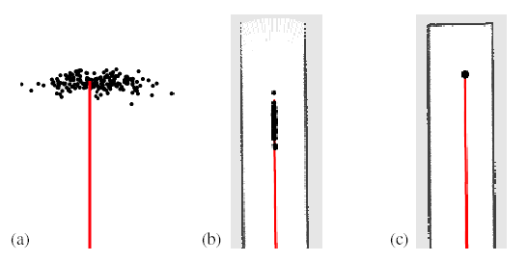
Improved Proposal
The proposal adapts to the structure of the environment

Slide 50
Selective Re-sampling
Re-sampling is dangerous, since important samples might get lost
(particle depletion problem)
In case of suboptimal proposal distributions re-sampling is necessary to achieve convergence.
Key question: When should we re-sample?

Slide 51
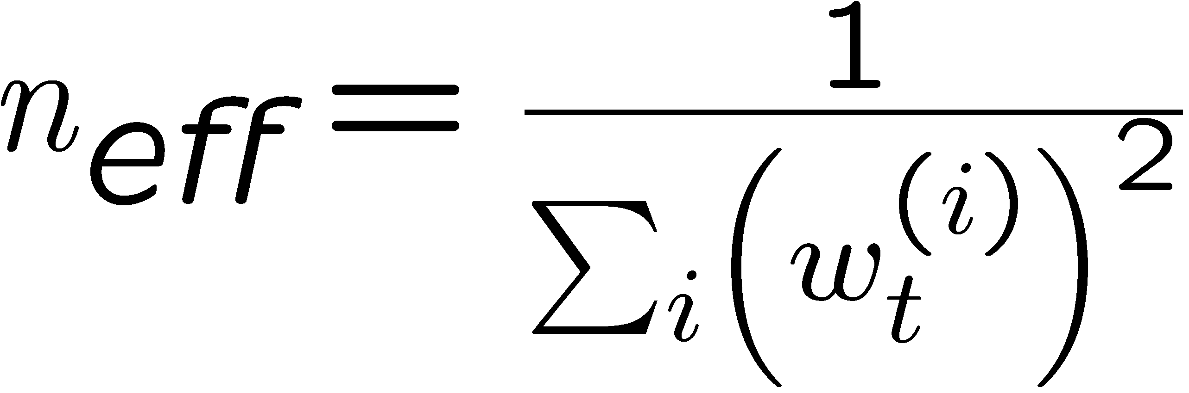
Number of Effective Particles
Empirical measure of how well the goal distribution is approximated by samples
drawn from the proposal
n_{eff} describes “the variance of the particle weights”
n_{eff} is maximal for equal weights. In this case, the distribution is close to the proposal

Slide 52
Resampling with Neff
Only re-sample when n_{eff} drops below a given threshold (n/2)
See [Doucet, ’98; Arulampalam, ’01]

Slide 53
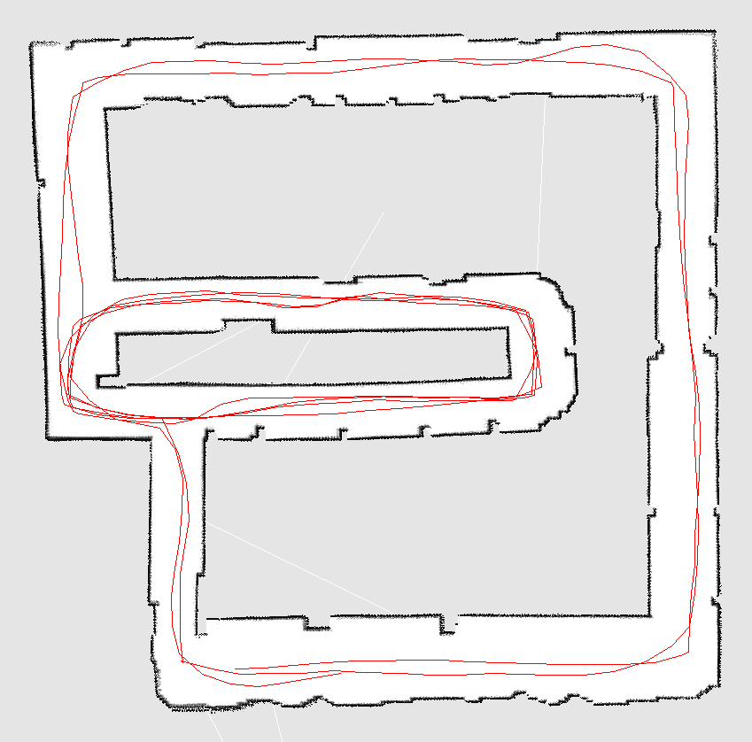
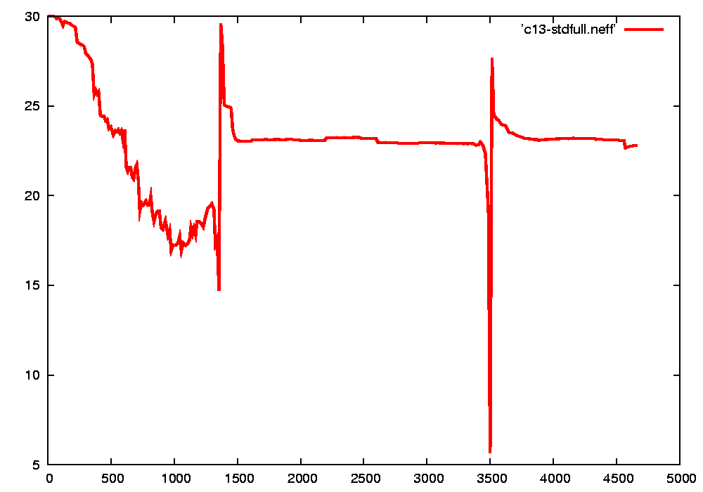
Typical Evolution of n_{eff}
visiting new areas
closing the first loop
visiting known areas
second loop closure

Slide 54
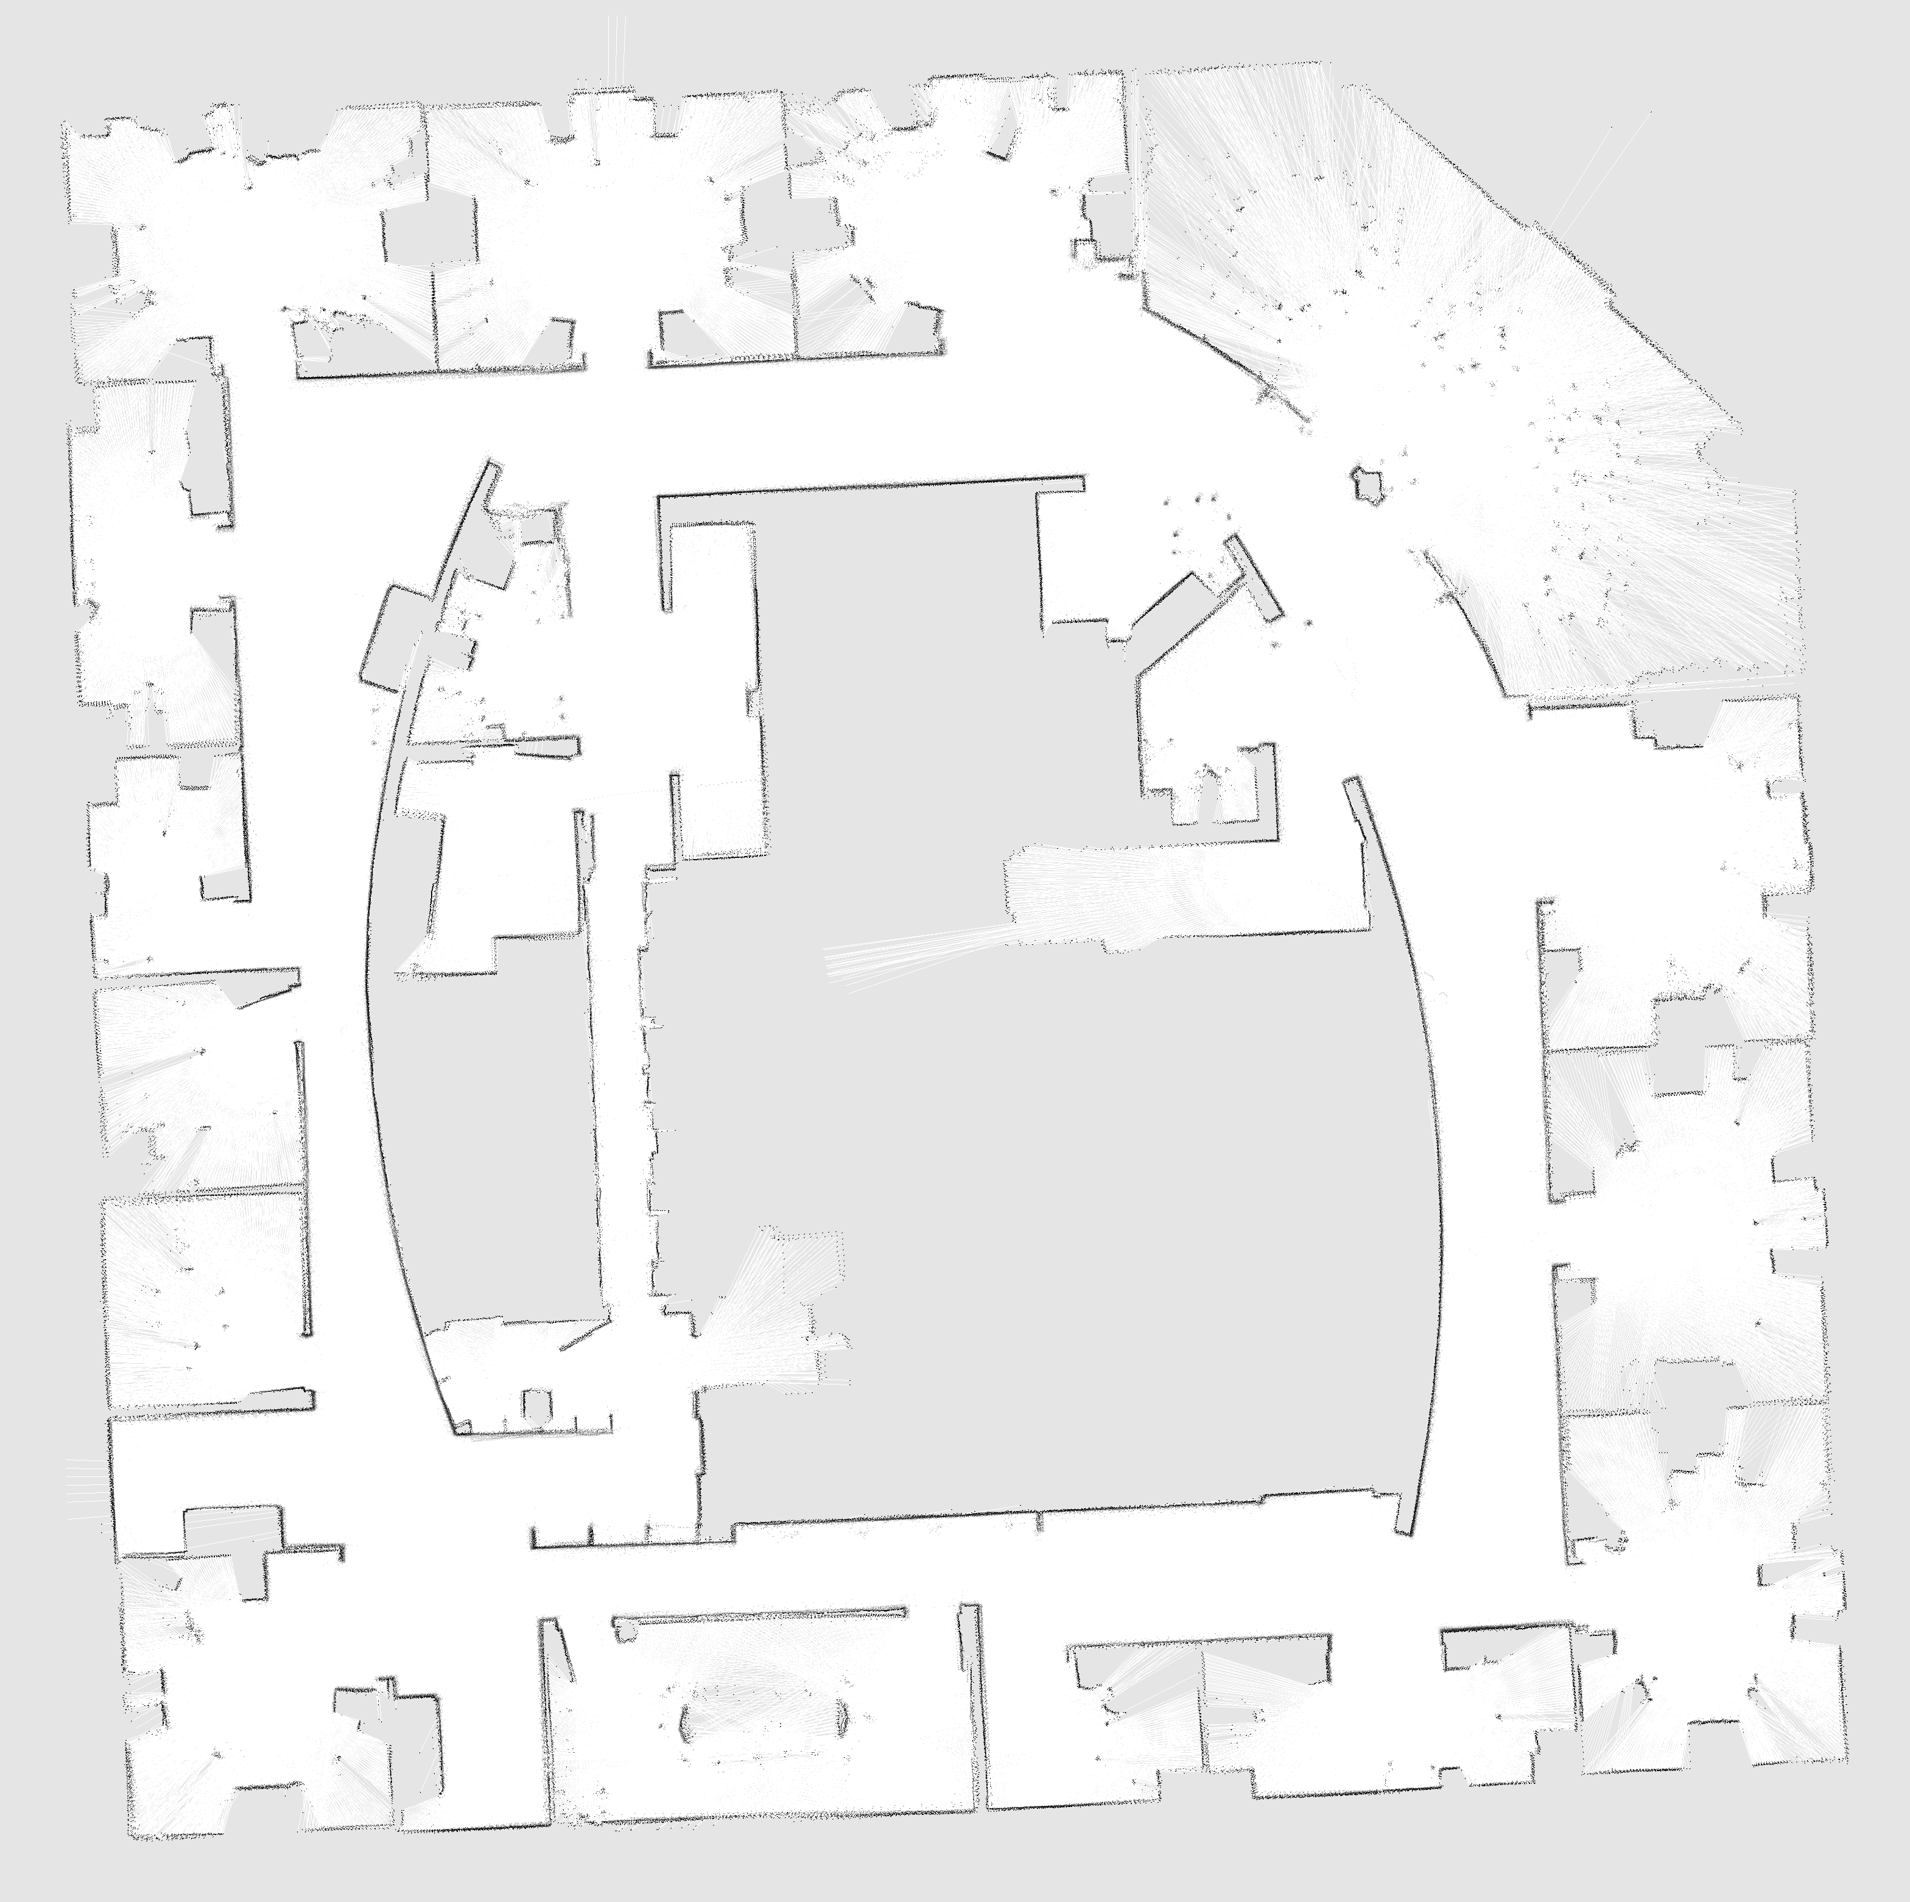
Intel Lab
15 particles
four times faster than real-time
P4, 2.8GHz
5cm resolution during scan matching
1cm resolution in final map

Slide 55
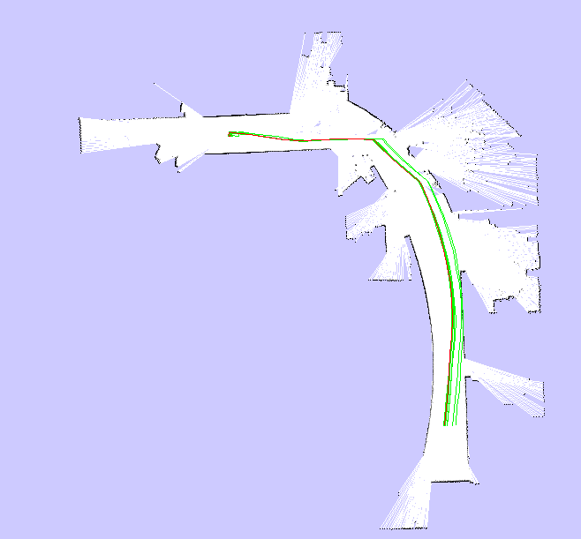
Intel Lab
15 particles
Compared to FastSLAM with Scan-Matching,
the particles are propagated closer to the true distribution

Slide 56
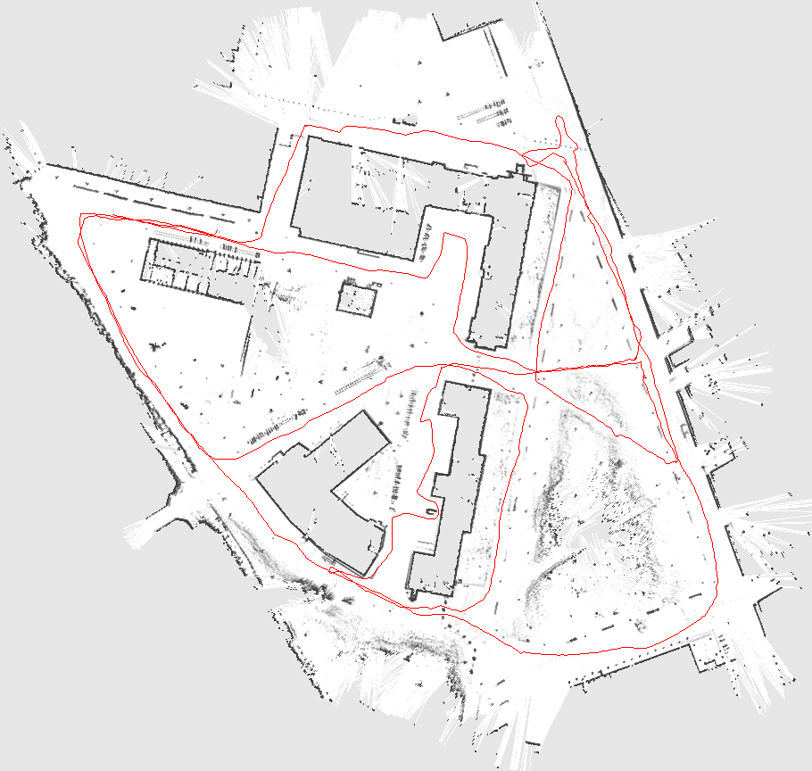
Outdoor Campus Map
30 particles
250x250m²
1.75 km (odometry)
20cm resolution during scan matching
30cm resolution in final map
30 particles
250x250m²
1.088 miles (odometry)
20cm resolution during scan matching
30cm resolution in final map

Slide 57

Outdoor Campus Map - Video

Slide 58
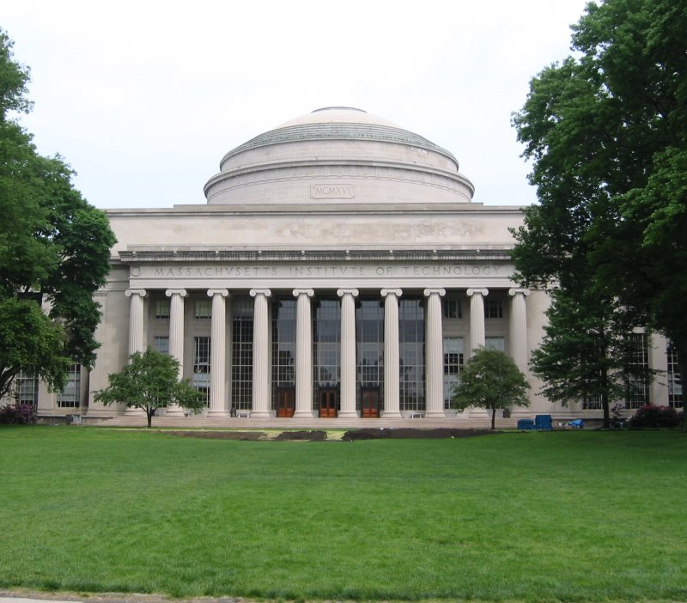
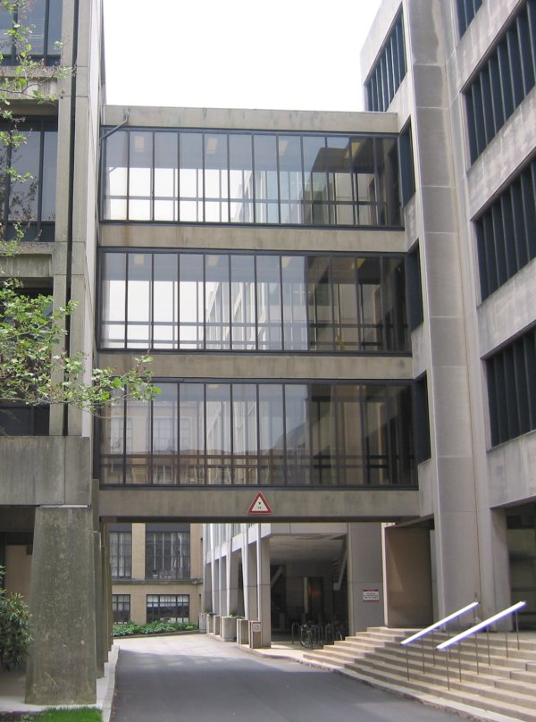
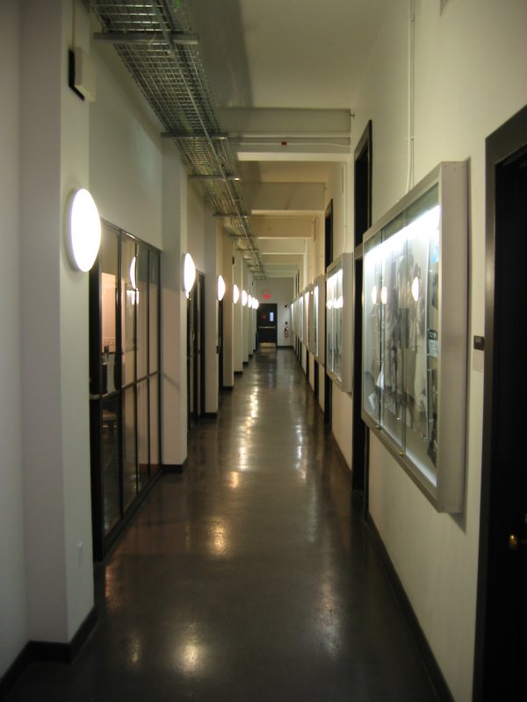
MIT Killian Court
The “infinite-corridor-dataset” at MIT

Slide 59
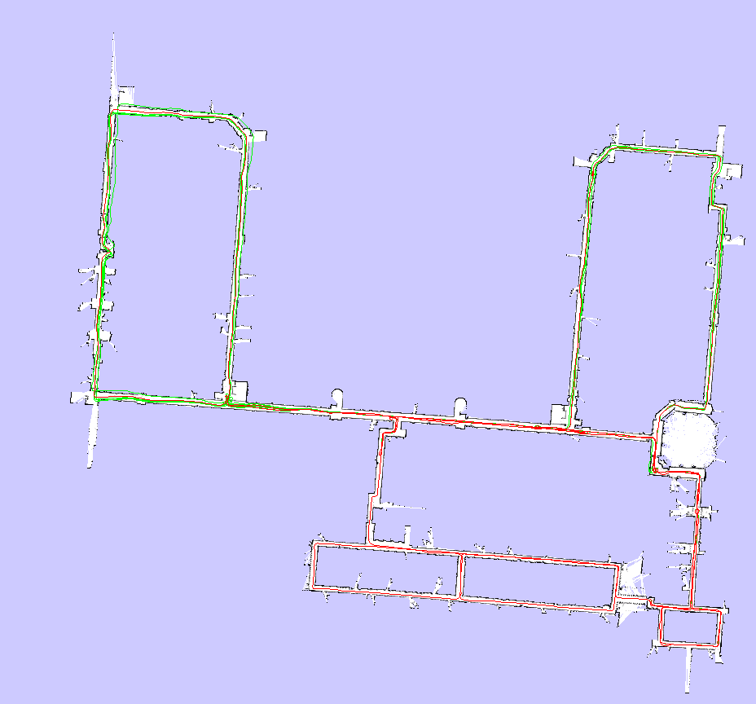
MIT Killian Court

Slide 60

MIT Killian Court - Video

Slide 61
Conclusion
The ideas of FastSLAM can also be applied in the context of grid maps
Utilizing accurate sensor observation leads to good proposals and highly efficient filters
It is similar to scan-matching on a per-particle base
The number of necessary particles and
re-sampling steps can seriously be reduced
Improved versions of grid-based FastSLAM can handle larger environments than naïve implementations in “real time” since they need one order of magnitude fewer samples

Slide 62
More Details on FastSLAM
M. Montemerlo, S. Thrun, D. Koller, and B. Wegbreit. FastSLAM: A factored solution to simultaneous localization and mapping, AAAI02
D. Haehnel, W. Burgard, D. Fox, and S. Thrun. An efficient FastSLAM algorithm for generating maps of large-scale cyclic environments from raw laser range measurements, IROS03
M. Montemerlo, S. Thrun, D. Koller, B. Wegbreit. FastSLAM 2.0: An Improved particle filtering algorithm for simultaneous localization and mapping that provably converges. IJCAI-2003
G. Grisetti, C. Stachniss, and W. Burgard. Improving grid-based slam with rao-blackwellized particle filters by adaptive proposals and selective resampling, ICRA05
A. Eliazar and R. Parr. DP-SLAM: Fast, robust simultanous localization and mapping without predetermined landmarks, IJCAI03

